Slide 1
Unravelling Experimental Constraints
Nathan Justus

Slide 2
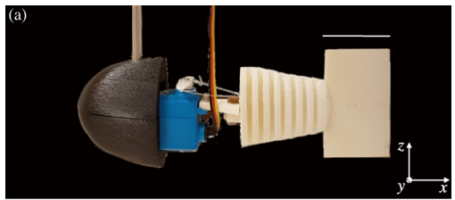
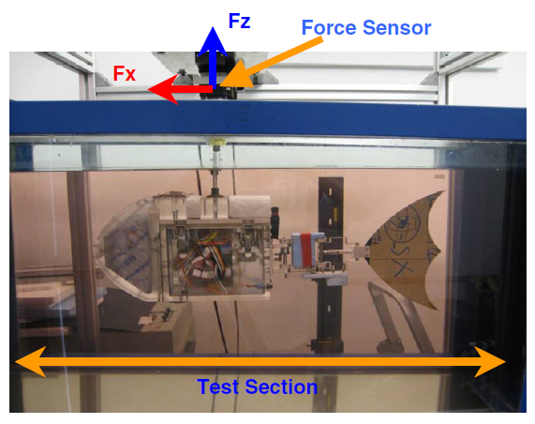
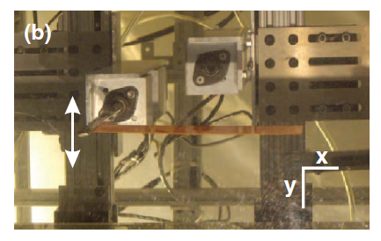
Constrained experiments seem useful

Slide 3
…But studying locomotion with them is very difficult

Slide 4
Categorizing ‘dimensions’ of a swimmer
Total Configuration Space
Position Space
(position, orientation)
Shape Space
(body arrangement)
Free
Dimensions (swimmer can move)
Constrained
Dimensions
(swimmer is fixed)
Active
Shape Modes
(motorized joint)
Passive
Shape Modes
(uncontrolled joint)

Slide 5
Experimental Information
Useful Position Data
Useful Force Data
Free Dimensions (swimmer can move)
Constrained Dimensions
(swimmer is fixed)
Active Shape Modes
(motorized joint)
Passive Shape Modes
(uncontrolled joint)

Slide 6
What is the likely goal for locomotion experiments?
Select coefficients to best match locomotion model
Body Parameters
Hydrodynamic Masses/Inertias
Drag Coefficients
Passive Joint Parameters
Spring Constant(s)
Damping Constant(s)

Slide 7
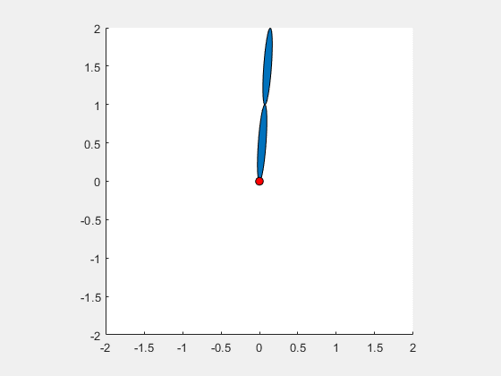
But that might not always be possible
Example Experiment
Y properties
X properties
First link does not move in its local X frame!
This experiment gives no information about
one link’s x-direction mass or drag properties

Slide 8
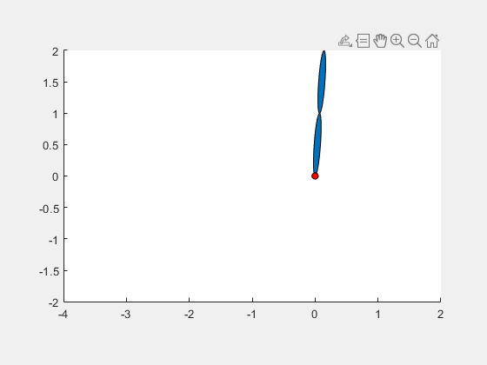
Can we use a flowtank to fix this?
Same Experiment in Flowtank
First link moves in X now…
But is it good enough? How do we know?
How do we tell in general if an experiment
provides sufficient information
to observe all hydrodynamic properties?
When are coefficients ‘Observable’?

Slide 9
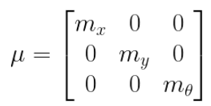
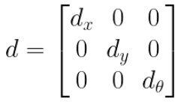
Math Time: Motion Model from Coeffs
Local Link Mass Tensor
Local Link Drag Tensor
Pulled back mass matrix
Pulled back drag matrix
Forced Equation of Motion

Slide 10
Isolate one coefficient
Break down local mass tensor.
We can separate coefficients!
From EOM, force contribution is linear to coefficient!

Slide 11
Repeat for all coefficients
Total force is a clean linear expression wrt coefficients
Experimental Forces
Coefficient Vector
Sensitivity Matrix

Slide 12
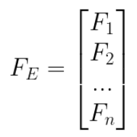
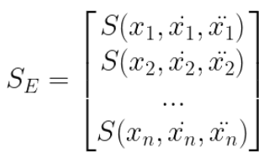
Determining Coefficients/Observibility
Sample forces/positions many times over experiment
Stack ‘em
Pseudoinverse to find best fit
Coefficients are observable from experiment if
sensitivity matrix is full column rank

Slide 13
Preliminary Results
Next Questions
Still tank experiment unobservable
as expected
Flow tank experiment observable
good news!
Pseudoinverse data works
What if we don’t know the center of mass and drag?
How do we do this for continuously flexible systems?
Will this best-fit unmodelled effects?
Vortex shedding
Laminar -> Turbulent flow transitions
Surface effects

