Slide 1
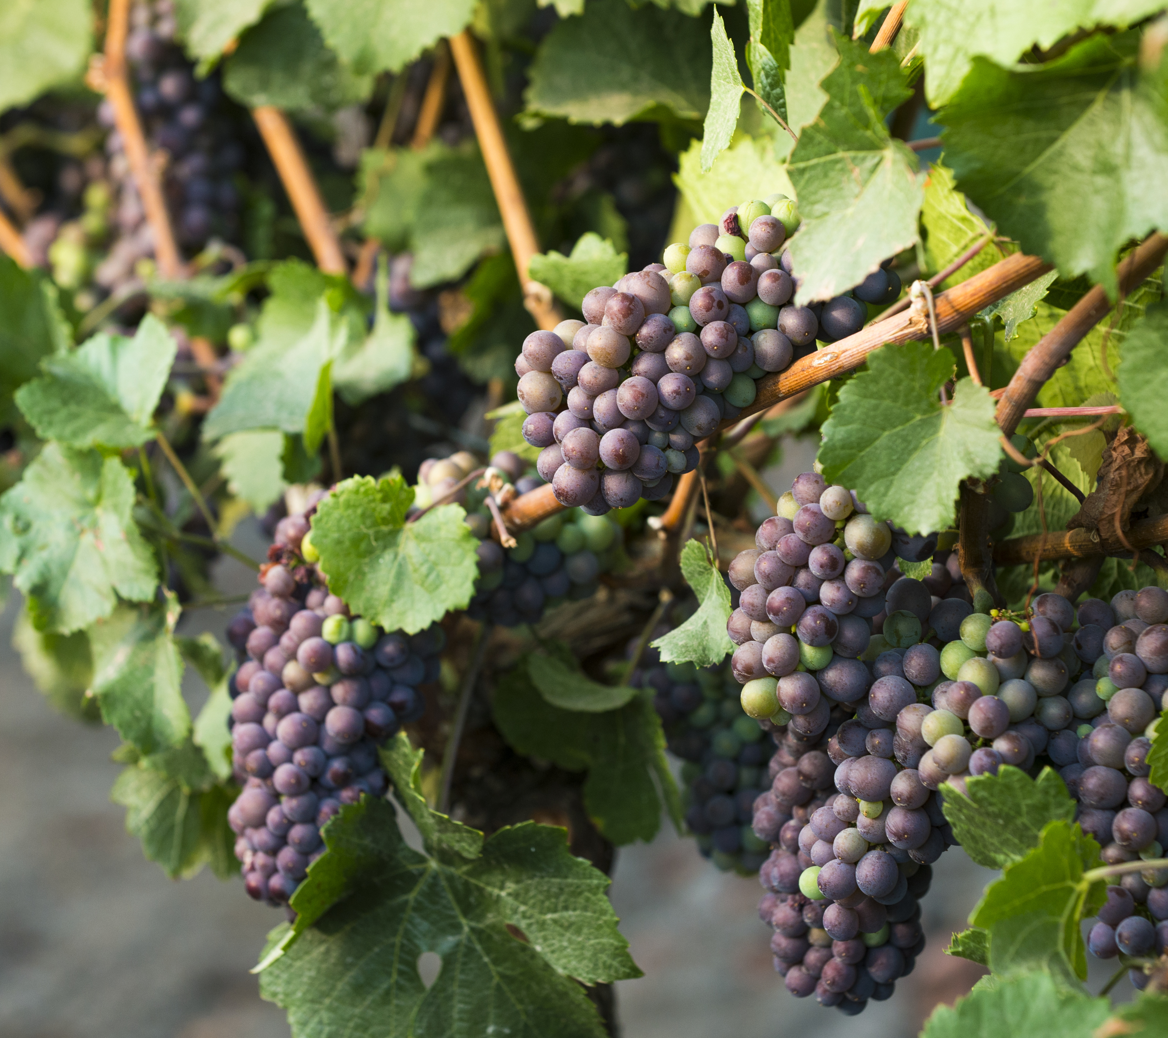
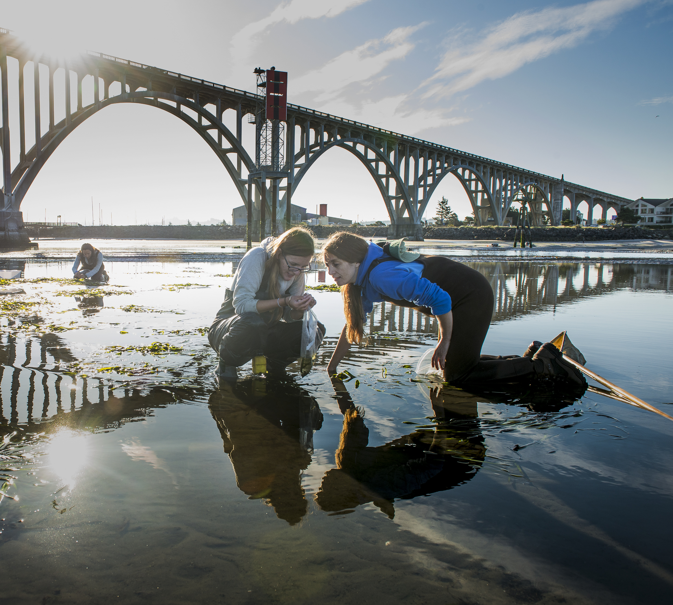
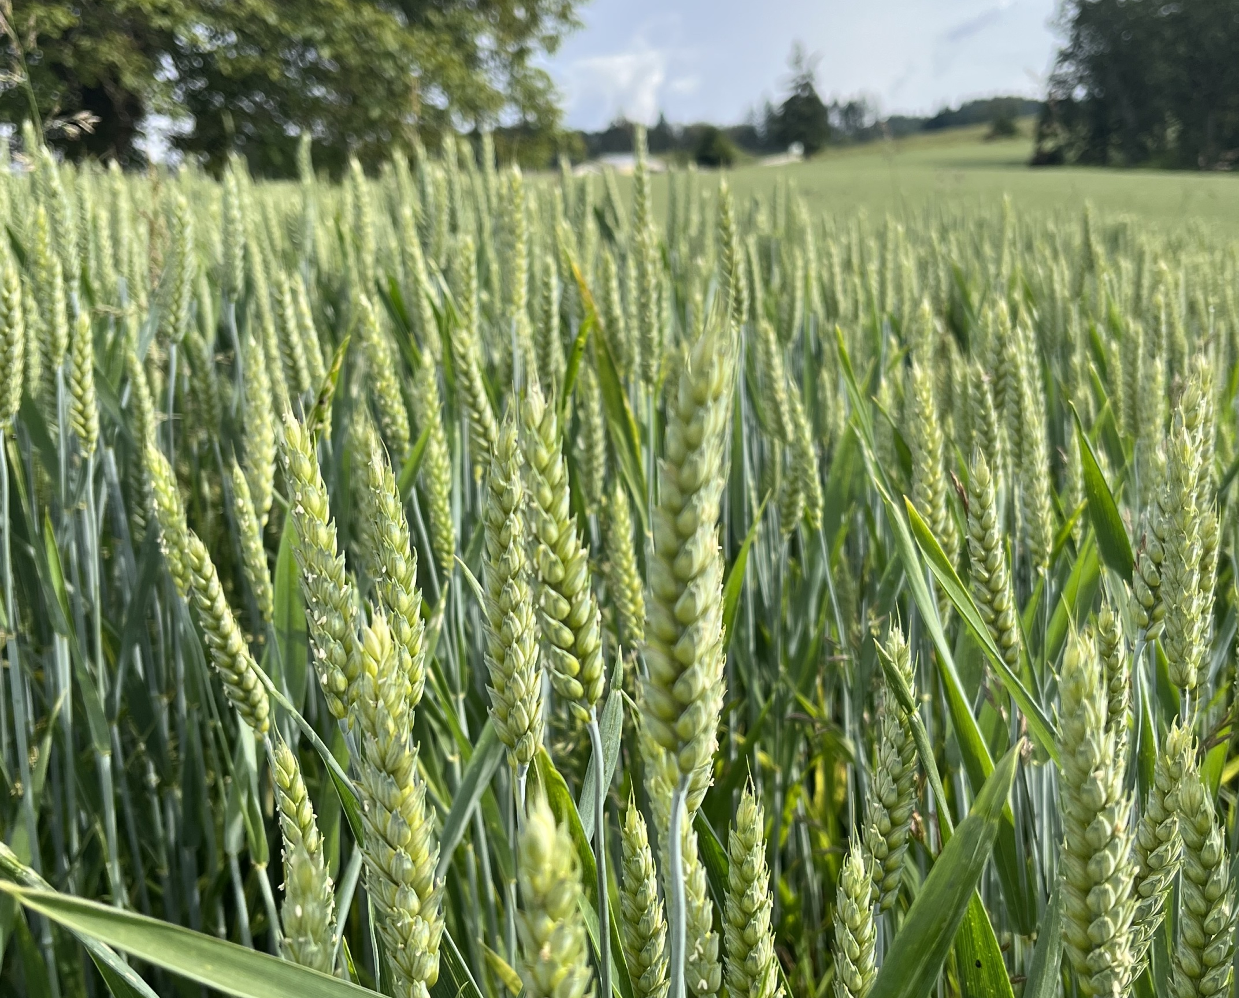
College of Agricultural Sciences
Branch Experiment Stations Research Internships
Get paid to work with researchers across Oregon!
This program provides $5000 to undergraduate students to conduct a semi-independent research project at an OSU Branch Experiment Station.
Successful applicants expected to spend between 10-13 weeks at the station.
Most opportunities during summer term; however, some during fall/winter/spring.
Find out more about the program and access the application:
Applications due Monday, April 1, 2024 @ 11:59pm
Accommodations for disabilities may be made by contacting 541-737-2211 or rachel.jones@oregonstate.edu.

