Slide 1
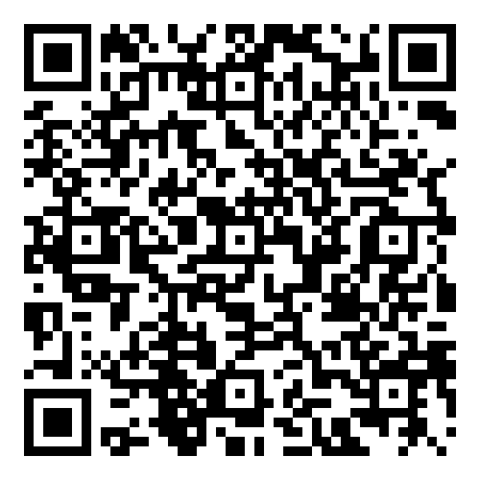
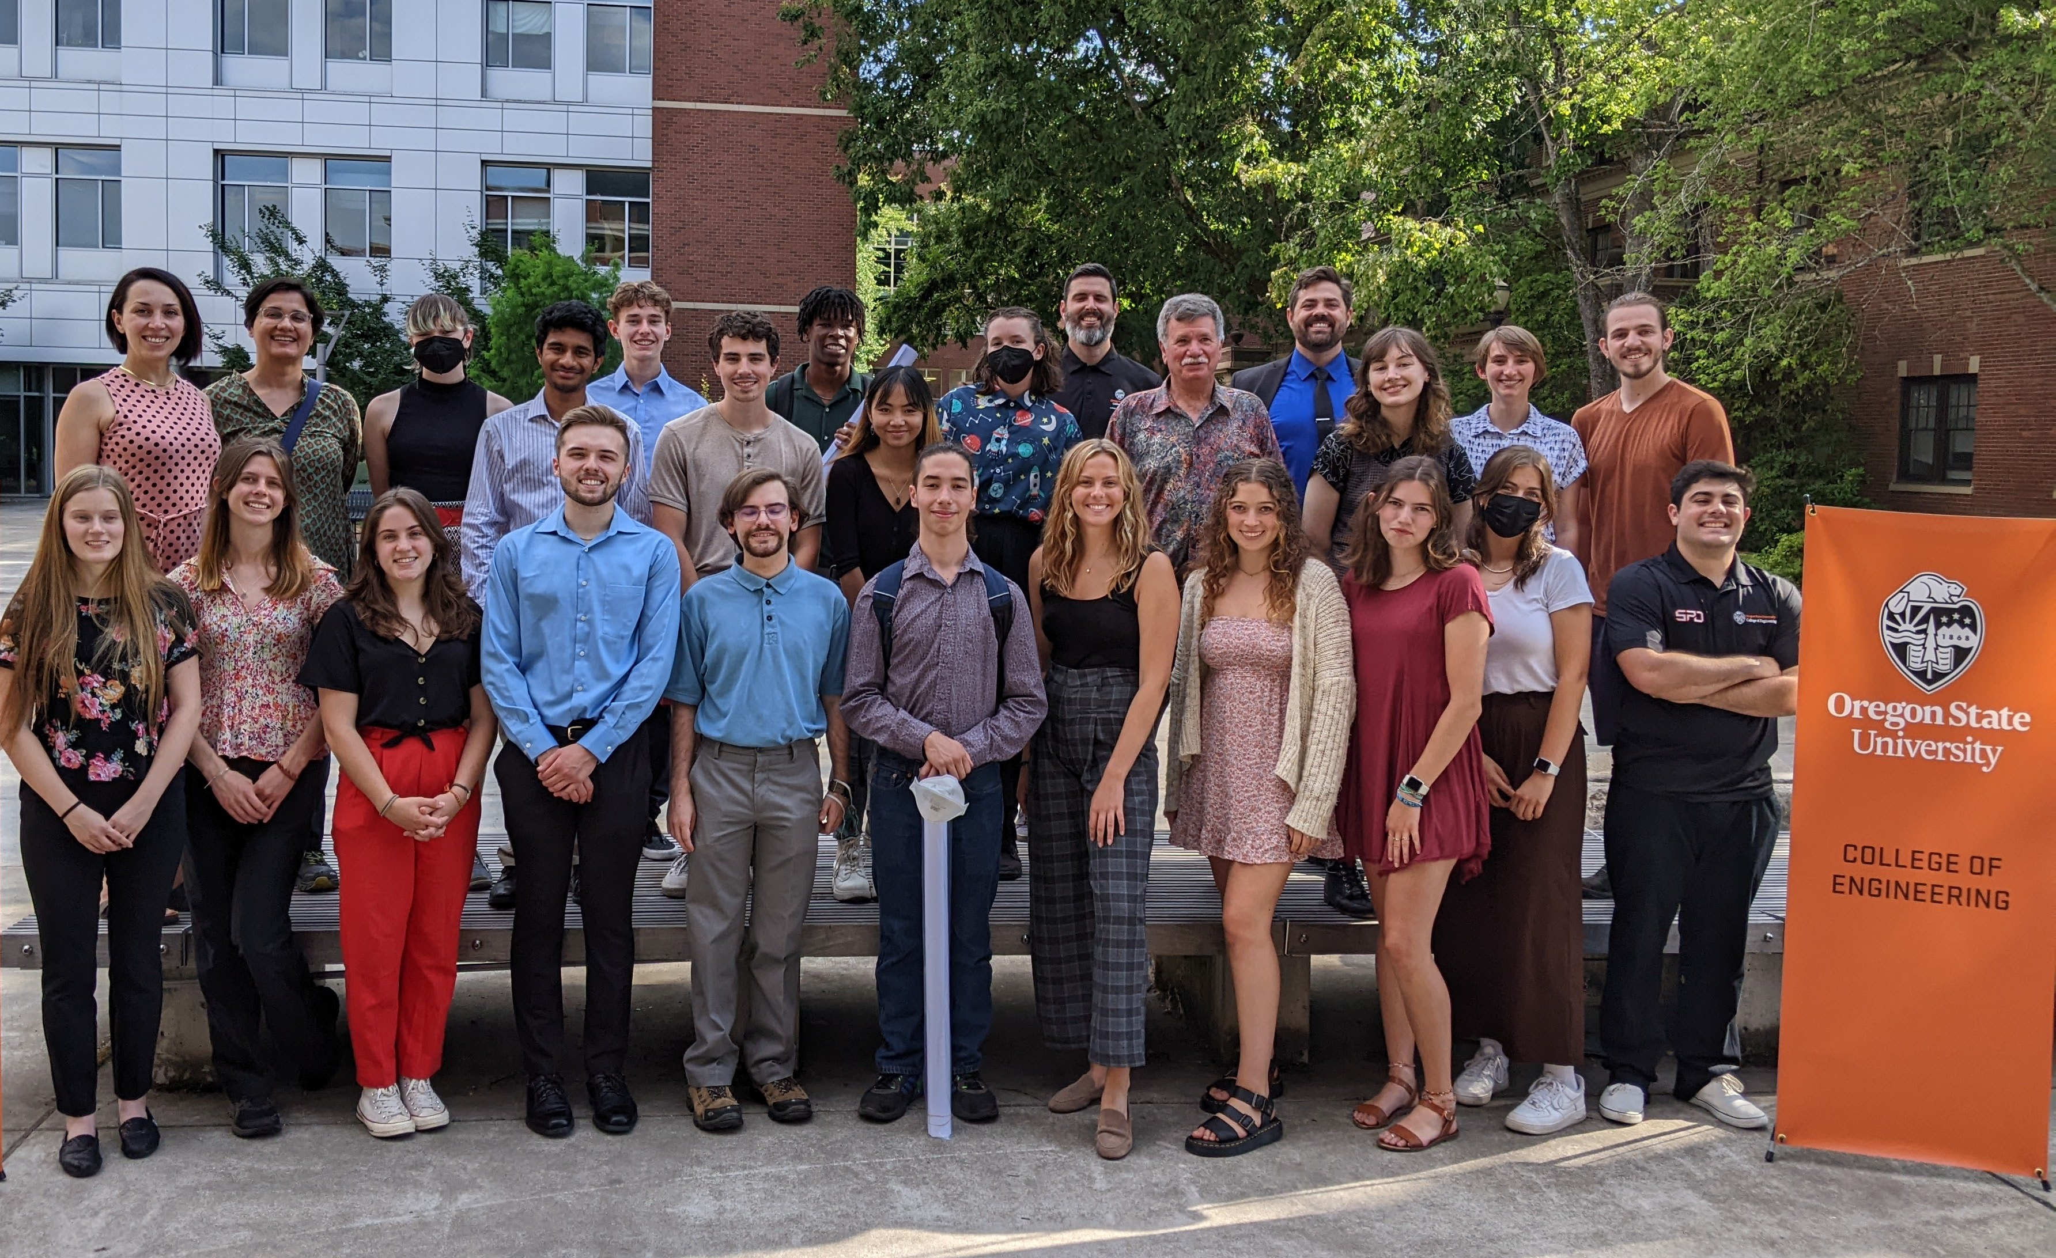
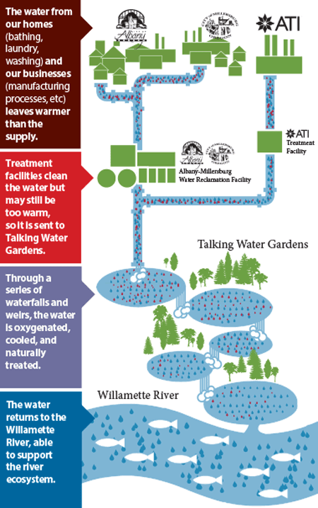
COLLEGE OF ENGINEERING
Clean Water Technology
Research Experiences for Undergraduates (REU) Summer 2024
June 17 to August 23, 2024
Oregon State University is excited to announce summer research experiences for undergraduate students interested in conducting hands-on and interdisciplinary research on how the field of engineering can contribute to clean water solutions. The Clean Water REU program will award a number of fellowships of $6,000 per student to support participation in research projects. During the ten-week program, students will work with a faculty mentor and graduate student on a specific project and will develop research skills that will help facilitate graduate school opportunities.
$6,000 fellowship
Field trips
Workshops for professional skills development
Learn more and apply at: https://engineering.oregonstate.edu/tools-services/research-experiences-undergraduates
Applications available: April 5, 2024
Application deadline: April 22, 2024
Notification of acceptance: May 9, 2024
For queries, please contact Dr. Dorthe Wildenschild (dorthe@engr.orst.edu)

