Slide 1
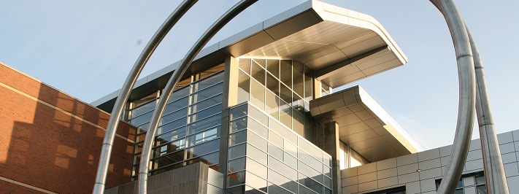
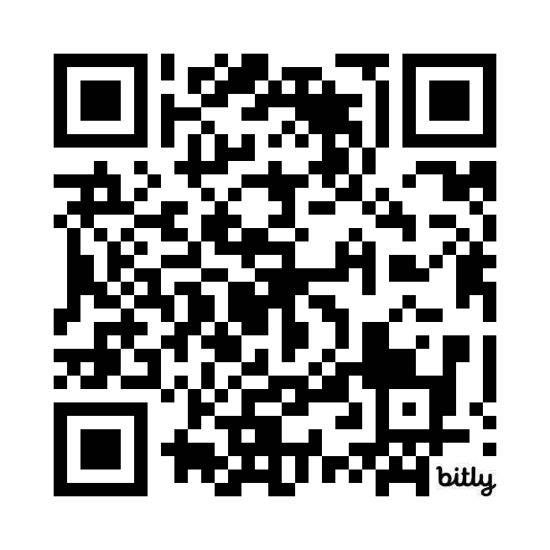
College of Engineering | School of Electrical Engineering and Computer Science
May 2 Reliable Robotics Day
Wants:
Computer Science
Electrical Computer Engineers
Mechanical Engineers
Physics
Other Engineering + Science
Business
Quick 30-minute sessions
KEC 1001
Reserve your seat
http://bit.ly/May2RR

