Slide 1
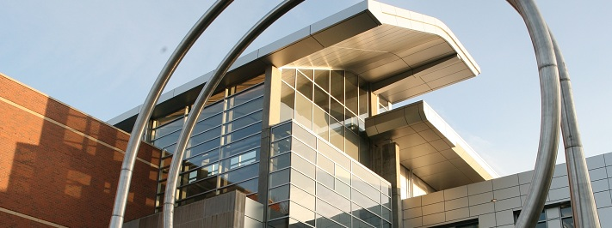
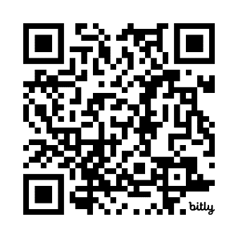


College of Engineering | School of Electrical Engineering and Computer Science
Feb. 20 HKN hosts Micron
Wants Science & Engineering
Feb. 20 @ 5-7 pm | KEC 1007
*Food*
Register on Handshake
https://bit.ly/Micron20
Electrical Computer Engineers
Mechanical Engineers
Chemical Engineers
Computer Science
Chemistry
Materials Science
Physics + more!

