Slide 1
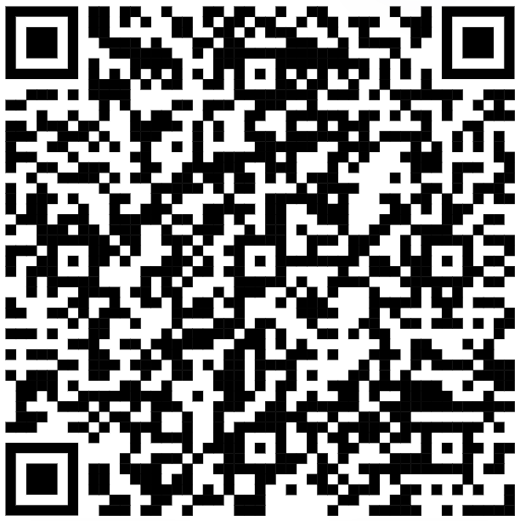
Want to help solve the plastic waste problem?
Join us to learn how Agilyx and Cyclyx are working together to increase plastic recycling rates from 10% to 90%! They believe it is time to expand recycling by giving post-use plastic a new, circular life!
We are hiring! As the operations and partnership continue to grow, they will need people who are equally committed to making a positive impact!
Friday, May 12 – 12 p.m. to 1 p.m.
Virtual info session
Register in Handshake
Accommodations for disabilities may be made by contacting Josefine.fleetwood@oregonstate.edu.

