Slide 1
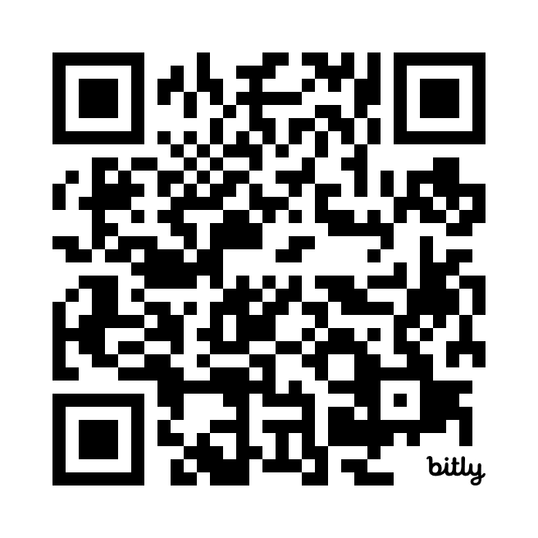
College of Engineering | School of Electrical Engineering and Computer Science
Info Sessions
Hosting Multiple Sessions
Feb. 6 @ 10 am-6 pm
Register on Handshake
http://bit.ly/Intel24
Wants:
Chemical Engineers
Chemistry
Materials Science
Mechanical Engineers
Other Engineering Majors
Physics

