Slide 1
Alumni presentation: Gilead Sciences, Inc.
Casey Hurley, Senior Research Associate I
Marisa Thierheimer, Research Associate
Formulation & Process Development

Slide 2
Casey’s Background
Senior Research Associate I, FPDª at GSI^{b} (started June 2016)
Masters student at KU^{c} studying Pharmaceutical Chemistry (expected graduation: May 2023)
Thesis: Kinetic evaluation of nitrosamine formation in solid drug product
Honors B.S. in Bioengineering with a minor in Chemistry (graduated June 2016)
Honors thesis: Formation and migration of breast cancer spheroids (Dr. Bo Sun, Biochemistry/Biophysics dept., OSU)
Senior project: Tablet driven microfluidic platform for cell counting (Dr. Minish Giri, HP, Corvallis, Oregon)
7 years of research experience in various fields:
The Hoffman Lab with Dr. Angela Hoffman, Chemistry dept., UP
Project: Medicinal properties of Holodiscus discolor
Interpersonal Sensitivity Lab with Dr. Frank Bernieri, Psychology dept., OSU
Project: Correlation between face shapes and personality traits
The Higgins Lab with Dr. Adam Higgins, Bioengineering dept., OSU
Robotics and Human Control Systems Lab with Dr. Ravi Balasubramanian, Mechanical Engineering dept., OSU
Internship: Clean room technician at Siltronic Inc. in Portland, Oregon
Formulation and Process Development
Gilead Sciences, Inc.
University of Kansas

Slide 3
Marisa’s Background
Research Associate, FPD at GSI (started July 2019)
Honors B.S. in Chemical Engineering (graduated June 2019)
Honors thesis: Assessment of roles for the Rho-specific guanine nucleotide dissociation inhibitor Ly-GDI in platelet function
Biomedical lab-based research
Spinal disc rheology with Dr. Skip Rochefort
Pseudomonas aeruginosa rheology, whole-blood rheological assay development with Dr. Travis Walker
Platelet mechanisms and systems biology research at OHSU with Dr. Owen McCarty
Multiple Engineering Co-Operative Program (MECOP)
ATI Specialty Alloys & Components
HP, Inc.
College of Engineering Ambassador
CBEE Club Officer

Slide 4
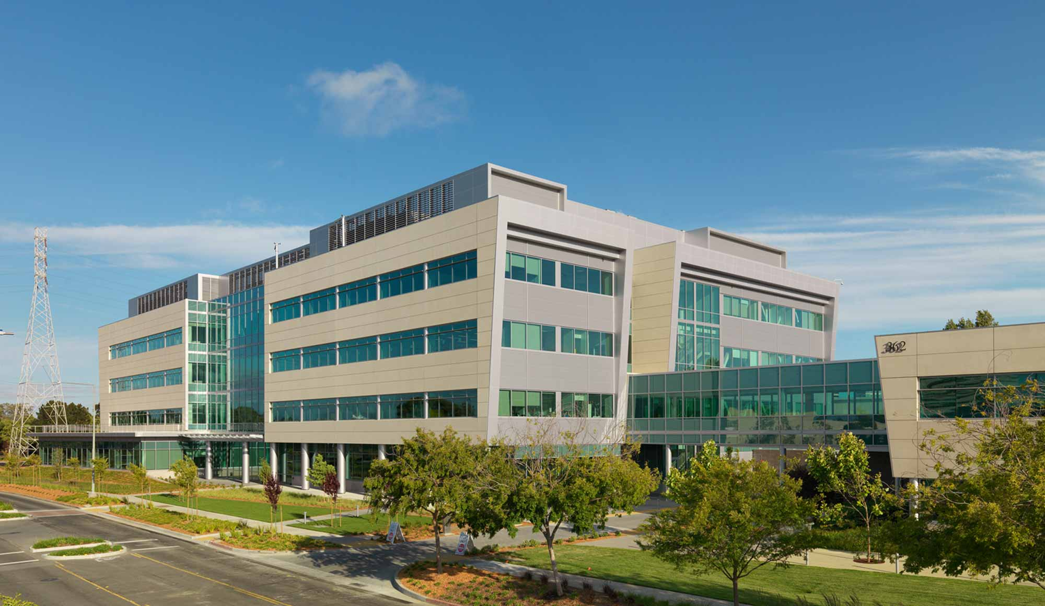
Gilead Sciences, Inc.
Small molecule (Foster City, CA)
Solid oral dosage: tablets, minitablets, taste masked oral granules
Other dosage forms: intravenous (IV) infusion (ex. remdesivir), liquid filled capsules, long-acting injectables
Biologics (Oceanside, CA)
Clinical manufacture and process development of biologics candidates in preclinical, Phase 1 and Phase 2 testing
Chimeric antigen receptor (CAR) T-cell therapy (Los Angeles, CA)
Kite Pharma acquired in 2017
Yescarta for Diffuse Large B-cell Lymphoma approved in 2017 (more cancer indications have been added since)
Antibody-drug conjugate (ADC) technology (NJ)
Immunomedics acquired in 2020
Gilead Access Program: increasing access to low- and middle-income countries for HIV/AIDS, viral hepatitis, and visceral leishmaniasis which include strategic partnerships to help with supplies and pricing

Slide 5
Therapeutic Areas
Virology
HIV: The first single tablet regimen and the first medicine to prevent HIV
Hepatitis: Curative treatments for chronic hepatitis C, therapies for hepatitis B, Hepcludex for Hepatitis Delta Virus
Oncology
Kite has one of the largest cell therapy research programs
Gilead works on small molecules for oncology targets
Inflammation
New treatments to help people with inflammatory diseases
Fibrosis
Non-alcoholic steatohepatitis
Treatment for rheumatoid arthritis approved in EU, Japan
Advance care for people with other conditions, including inflammatory bowel disease, cardiovascular disease

Slide 6
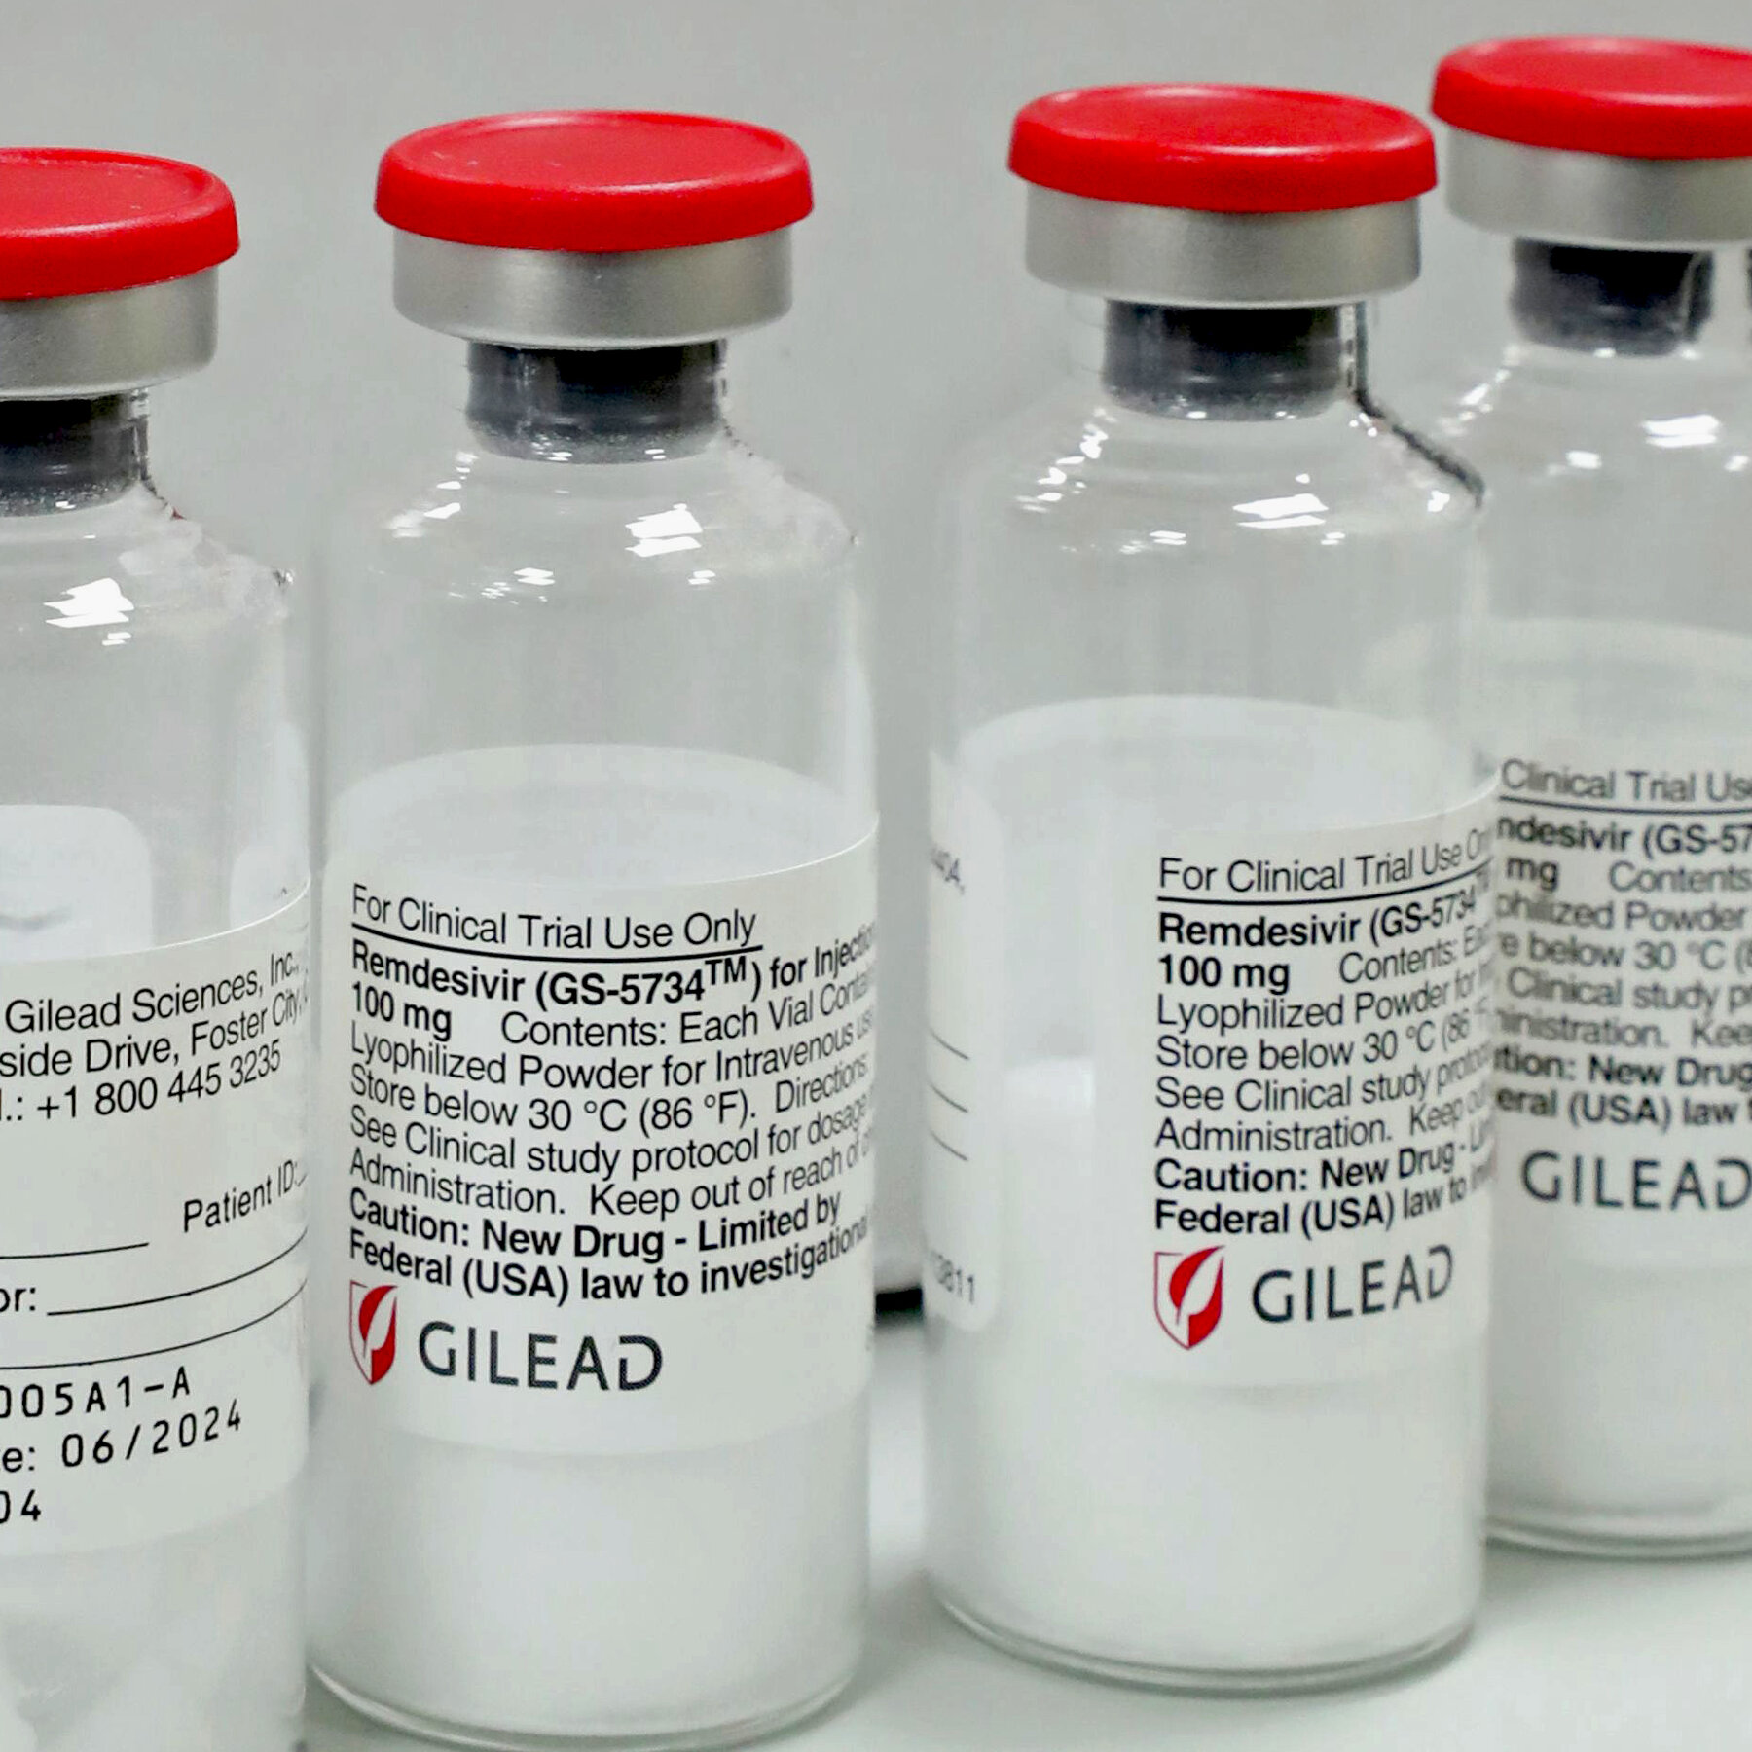
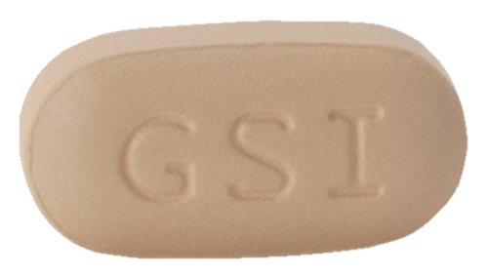
Timeline of FDA Approved Products
Vemlidy®
Trodelvy®
Harvoni®
Epclusa®
Tecartus®
Macugen®
Stribild®
Tybost®
Descovy®
AmBisome®
Hepsera®
Cayston®
Odefsey®
Veklury®
(remdesivir)
Tamiflu®
Truvada®
Letairis®
Truvada®
Zydelig®
Odefsey®
Biktarvy®
1990
1996
1999
2001
2002
2003
2004
2006
2007
2008
2010
2011
2012
2013
2014
2015
2016
2017
2018
2020
Vistide®
Viread®
Emtriva®
Atripla®
Lexiscan®
Complera®
Sovaldi®
Genvoya®
Vosevi®
Ranexa®
Viread®
Yescarta®
6

Slide 7
Selection
Characterization
Formulation and Manufacturing Process Development
Clinical Support
Commercial Support
Documentation
What do we do?

Slide 8
Selecting a Molecule for Development
Potentially screen hundreds of compounds before selecting the right molecule
Collaboration with research departments (i.e. Biology, Medicinal Chemistry, and Drug Metabolism)
Preclinical studies in multiple species to characterize pharmacokinetic properties of molecule
Some characterization of physical and chemical properties
Limited formulation development
Toxicology studies

Slide 9
Characterizing a Small-Molecule Drug (Preformulation)
Solution stability (pH, temperature, peroxide, metals, radicals, photo)
Solid-state physical and chemical stability (temperature, humidity, photo)
pKa determination
Crystal form screening
Biopharmaceutical performance evaluation
BCS classification
Thermal analysis
Moisture sorption isotherm
Surface and filter adsorption
pH solubility
Intrinsic water solubility
Solubility in biorelevant media
Solubility in solvents and pharmaceutical excipients

Slide 10
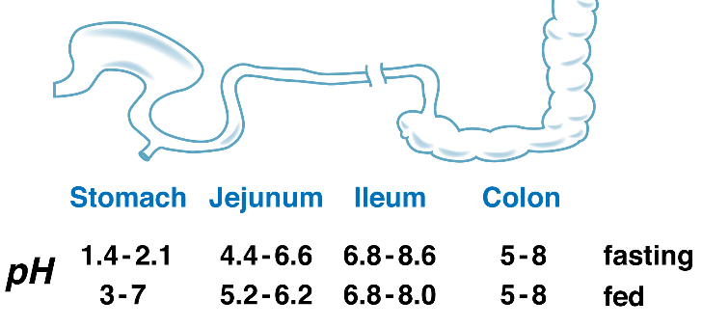
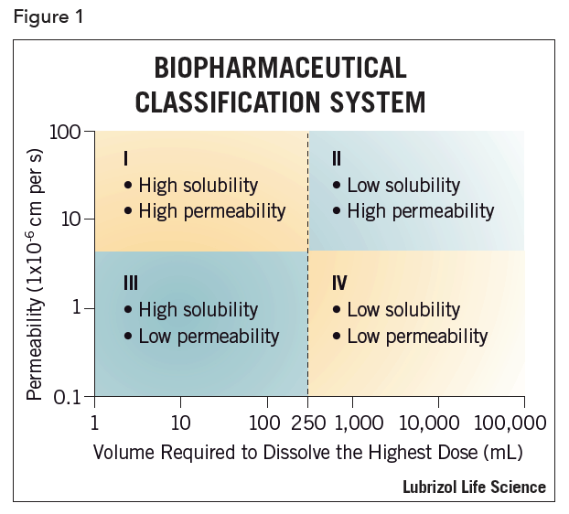
Characterizing a Small-Molecule Drug (Preformulation)

Slide 11
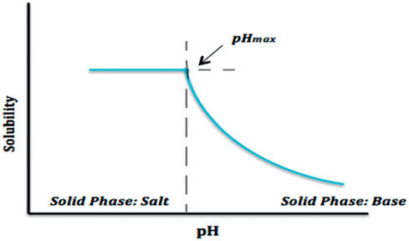
Form Selection
Work with crystallization group to select a solid form of the drug for clinical trials and eventually commercial
Amorphous
Crystalline
Salt
Form characterization
Solubility at physiological pH
Pharmacokinetic properties
Solution and solid-state stability

Slide 12
Development for Clinical Trials & Commercial Use
Tablet Formulation
Inactive ingredients
Filler
Disintegrant
Lubricant
Coating
Manufacturing processes
Granulation (dry vs wet)
Compression
Coating
Spray-drying
Hot melt extrusion
Long-Acting Formulation
Polymers
Low solubility forms
Liquid Formulation
Emulsion
Suspension
Solution
Routes
Oral (PO)
Subcutaneous (SC)
Intramuscular (IM)
Intravenous (IV)
Inhalation

Slide 13
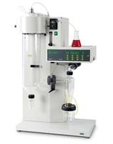
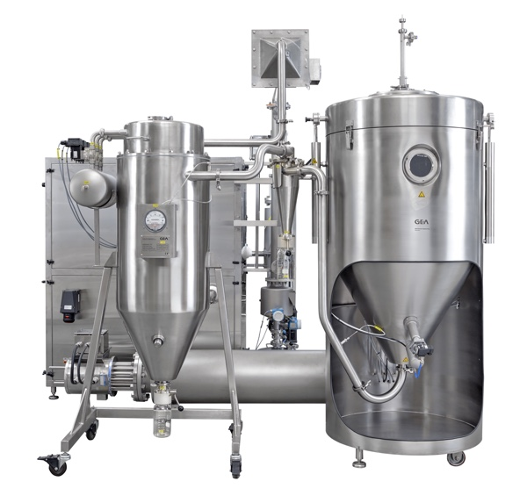
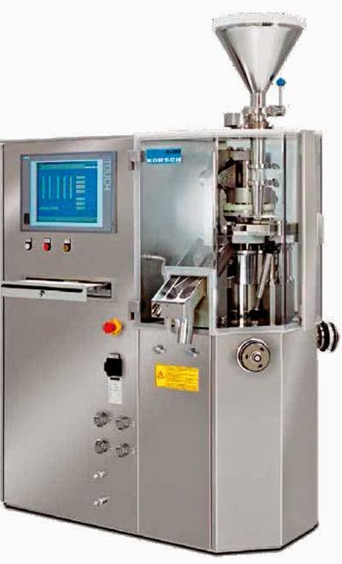
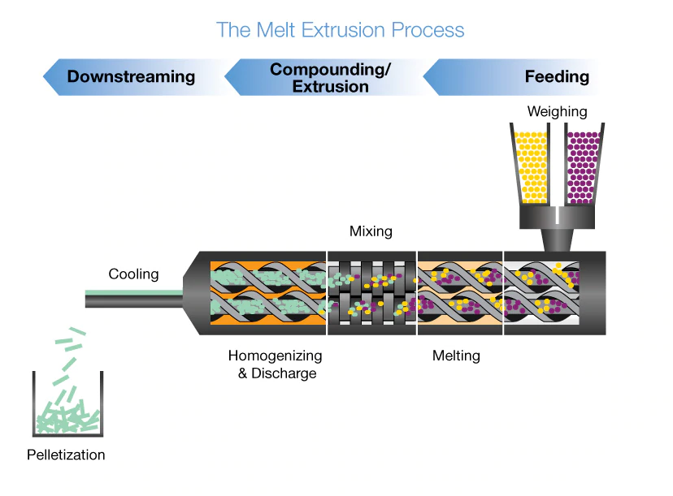
Tablet Manufacturing
Spray Drier
Rotary Tablet Press
Roller Compactor (Dry Granulation)
Hot Melt Extruder

Slide 14
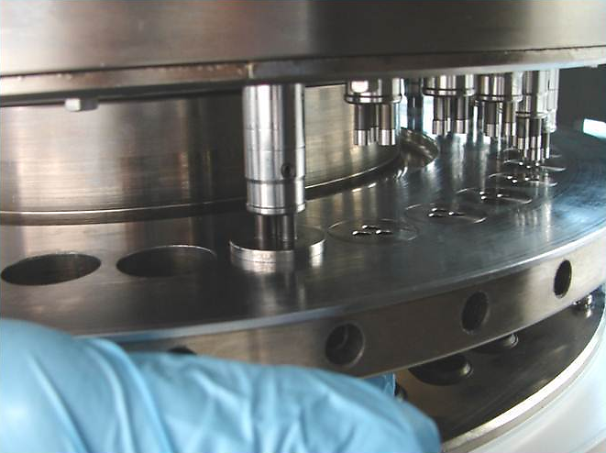
FPD Involvement in Commercialization of the Drug Product
Final formulation and manufacturing process selection
DOE studies: select compaction & compression parameters, final commercial formulation
Qualification of testing methods
Tech transfer to commercial manufacturing group
Batch release testing development support
Regulatory filings
Investigations

Slide 15
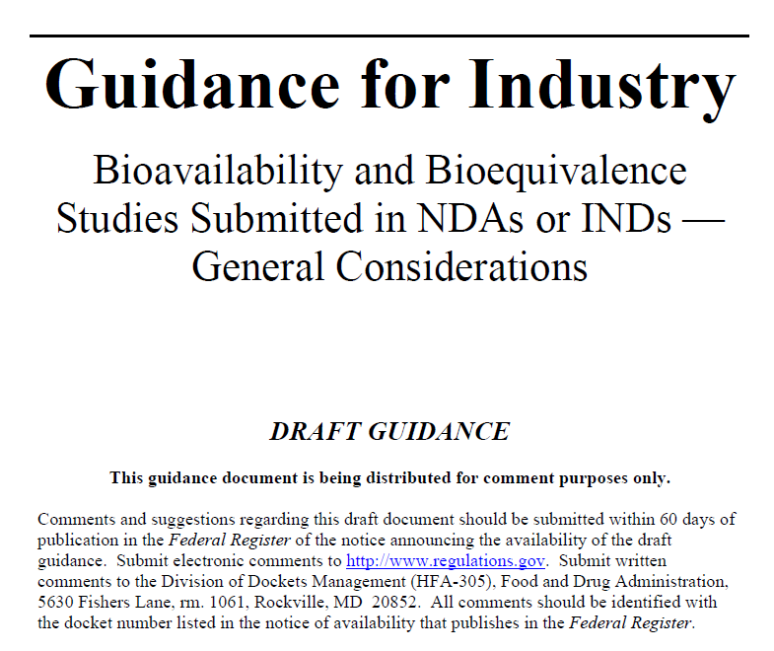
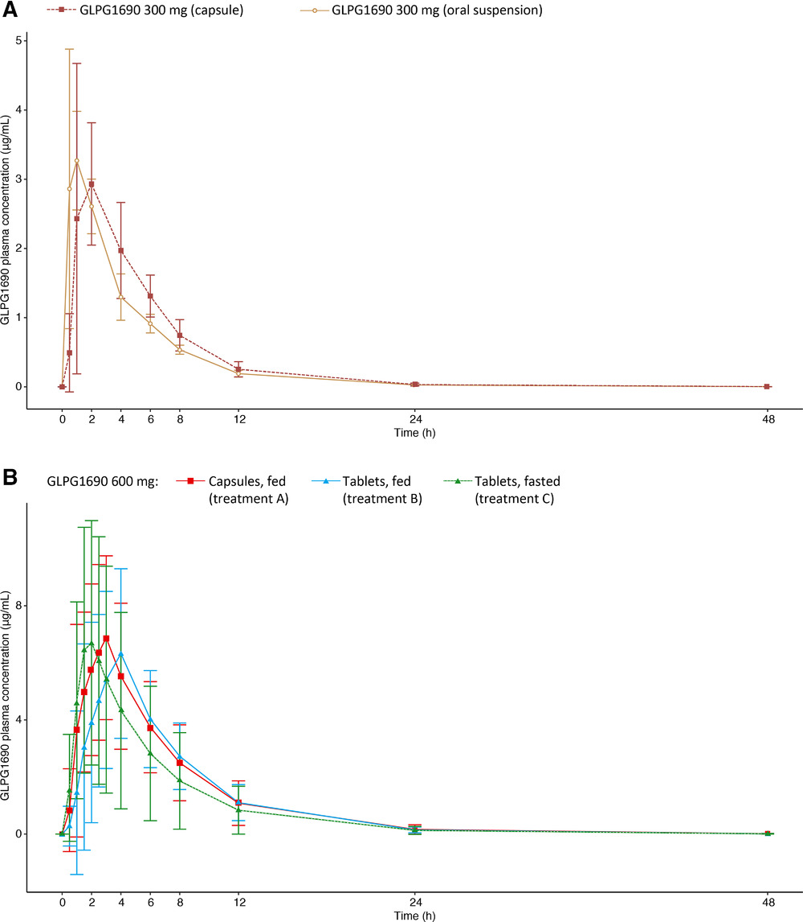
Report Writing
Types of Reports:
Preformulation
IND (Investigational New Drug) application
Manufacturing
NDA (New Drug Application)

Slide 16
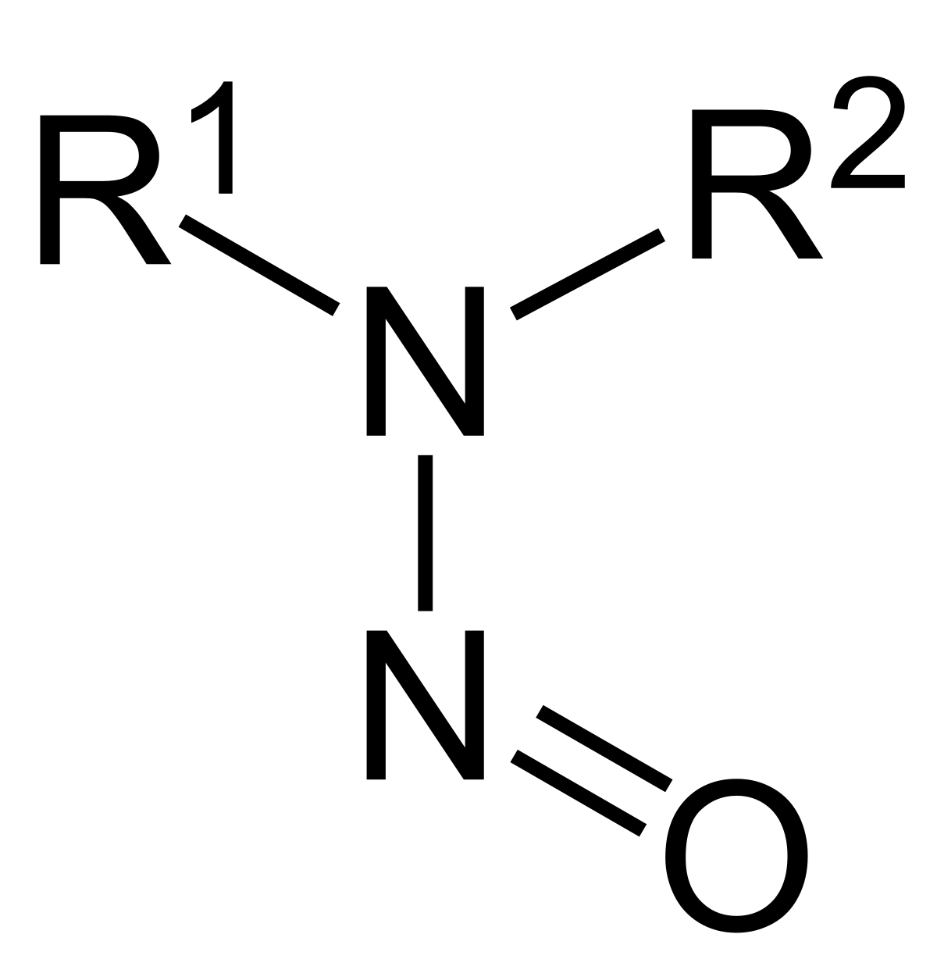
Case study: Nitrosamine Risk Assessment Task Force
Regulatory agencies are requiring all pharmaceutical companies to complete nitrosamine risk assessments of their commercial APIª and drug product by March 2021 due to recent recalls
Nitrosamines (a group of compounds identified as potential carcinogens) are caused by the reaction between 2º/3º amines and nitrites in an acidic environment (below pH 5)
Stressing analytical methods to limit due to low acceptable intake (AI) starting as low as 18 ng/day
Required to be below 10% AI to avoid batch release testing
Measuring on ng/g or ppb^{b} scale when most instruments LC/MS and GC/MS are suited for μg/g or ppm^{b} level
Using theoretical purge factors of unspecified impurities and mathematical models to predict the amount of nitrosamine at the end of drug product shelf-life (tied into thesis)
Team: employees from process chemistry, quality assurance, chemical outsourcing, nonclinical safety & pathobiology, regulatory affairs, analytical chemistry, packaging, FPD
Pandemic impact: zoom meetings, more email conversations, and slight delay in lab work depending on when personnel will be on-site
Lessons learned: always strive to continually learn and think creatively
Active pharmaceutical ingredient
Parts per billion and parts per million
Notes:
TTC = 1.5 ug/day

Slide 17
Case study: an international collaboration in the midst of a global pandemic
Gilead opted into a Phase III clinical molecule discovered by Galapagos NV
Task: develop a robust commercial formulation and prove that it is bioequivalent to the clinical formulation
Minimize tablet size while considering drug load in formulation (requirement to develop three strengths)
Perform dissolution experiments, conduct pharmacokinetic crossover studies using hand-pressed tablets
Plan, oversee, analyze results from development studies in Europe
Team: two scientists from GSI FPD, two from GSI AO, three from GLPG team
Pandemic impact: calls at odd times instead of travel to manufacturing site, more conscious of time spent in lab, increased strain on deliverable schedules
Lessons learned: be open-minded about different ways of doing things, rapidly-changing circumstances call for flexibility, hard work pays off (even if it's not in the ways we expected)

Slide 18
Career Advice
Don’t be afraid to network! We are living proof that it works. ☺
You will receive on-the-job training
There is always a learning curve, but it is made easier by background knowledge from school/internships
No need to “study” for your new job (but maybe a little for the interview)
Stay in contact with your professors, advisors, mentors – they will become your references, connections, letters of recommendation
Internships and research help build resume when you don’t have work experience
Good communication with manager and team about prioritization of tasks can help with work/life balance
The more exposure you get, the more recognition and opportunities you will receive (the pieces of PIE – 10% performance, 30% image, 60% exposure)

Slide 19
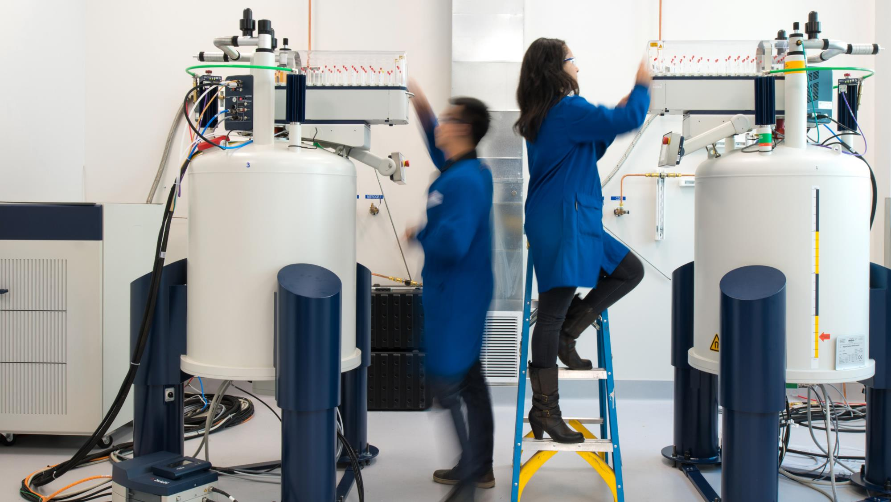
Questions?

