Slide 1
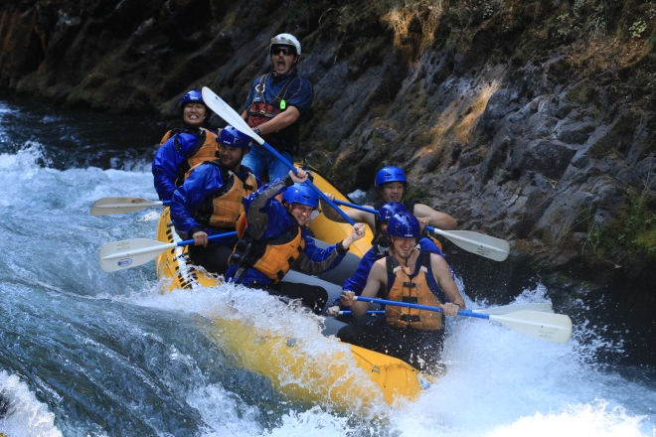
Smurfit WestRock Longview Roles:
Process Optimization and Process Control (Chem E)
Smurfit WestRock is looking for summer interns and full-time associates at our Longview, WA mill. We are seeking skilled, self-motivated, and results-driven people for these positions.
What would you be doing? Investigating and developing solutions in multiple areas of the production process including analyzing process units, simulation, and control implementation. We will give you meaningful projects that will make a difference – no busywork. Project work can involve both process control and process optimization. And last but not least, we think it’s important to have fun too!
How to apply: For instructions on how to apply, contact alexander.l.graham@westrock.com

Slide 2
Smurfit WestRock Longview Roles:
Reliability (ME and EE)
Smurfit WestRock is looking for summer interns at our Longview, WA mill. We are seeking skilled, self-motivated, and results-driven people for these positions.
What would you be doing? Focus on troubleshooting breakdown events and overall improvement of machine function. Tasks may include fact finding, data analysis, project management, drawing development, 5S work, and more. We will give you meaningful projects that will make a difference – no busywork. And last but not least, we think it’s important to have fun too!
How to apply: For instructions on how to apply, contact alexander.l.graham@westrock.com

Slide 3
Smurfit WestRock Longview Roles:
Capital Project Management (ME and EE)
Smurfit WestRock is looking for summer interns at our Longview, WA mill. We are seeking skilled, self-motivated, and results-driven people for these positions.
What would you be doing? Focus on developing and executing large projects to improve the mill. This could include data analysis and project justification, detailed project design, managing the project execution, and much more. We will give you meaningful projects that will make a difference – no busywork. And last but not least, we think it’s important to have fun too!
How to apply: For instructions on how to apply, contact alexander.l.graham@westrock.com

