Slide 1
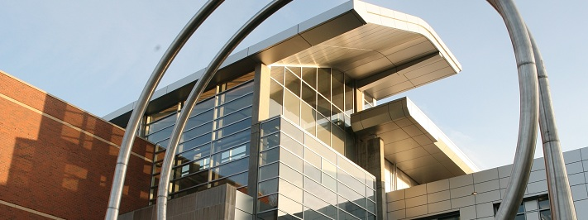



School of Electrical Engineering and Computer Science
Day
October 9 @ 11:00 am – 2:00 pm
Wants to meet: 1) Chemical Engineering, 2) Chemistry, 3) Computer Science, 4) Data Science, 5) Electrical Computer Engineering, 6) Materials Science, 7) Mechanical Engineering, 8) Physics
Register + Apply @ https://bit.ly/ResumeDay

Slide 2

School of Electrical Engineering and Computer Science
HKN hosts Engineering is Everywhere
October 9 @ 5:00 pm, KEC 1003 or Zoom
https://bit.ly/EECSWebWed
All College of Engineering + College of Science majors
To attend in person, register on Handshake.

Slide 3
School of Electrical Engineering and Computer Science
CBEE Club – Engineering is Everywhere!
October 11 @ noon pm, KEC 1003 or Zoom
https://bit.ly/EECSWebWed
Chemistry + CBEE + ECE + MatSci + Physics majors
Register on Handshake to attend in person.

